Slide 1
Road Traffic Accidents
By: Anand

Slide 2
Potential Technical Issues
GDPR Compliance
Data Security
Data Integrity
Data Duplication
Data Retention
Data Access Permissions
Performance
Scalability
Backup and Recovery
Data Governance
Notes:
GDPR Compliance: Storing personal information such as names requires compliance with data protection regulations. The General Data Protection Regulation (GDPR) in the UK. It includes ensuring that data is stored securely and only used for lawful purposes.
Data Security: The personal information is sensitive. the database must be designed to ensure data security. This includes using encryption for data at rest and in transit, implementing access controls, and regular security audits.
Data Integrity: Ensuring that the data remains accurate and consistent is crucial. It can be achieved through proper data validation and constraints such as ensuring that names are in the correct format and length.
Data Duplication: There may be instances where the same person is involved in multiple accidents. To avoid data duplication, there need to implement a mechanism to identify and link duplicate records.
Data Retention: The database will have a clear data retention policy to determine how long personal information is retained and when it should be deleted.
Data Access Permissions: Access to the database should be restricted to authorized personnel only. Implementing role-based access controls can help ensure that only those who need access to the data have it.
Performance: As the database grows the performance may become an issue. Proper indexing and query optimization can help improve performance.
Scalability: The database should be designed to scale as the amount of data increases. It will involve using techniques such as sharding or partitioning.
Backup and Recovery: Implementing regular backups and a robust recovery plan is essential to protect against data loss.
Data Governance: Establishing data governance practices such as data quality monitoring and auditing. It can help ensure that the data remains accurate and compliant with regulations.

Slide 3
Ethical Issues
Privacy Concerns
Data Security
Informed Consent
Data Accuracy and Bias
Secondary Use of Data
Transparency
Accountability
Data Sharing and Collaboration
Notes:
Privacy Concerns: Storing individual names in a database raises concerns about privacy especially if the data is not adequately protected. There is a risk of unauthorized access, misuse, or even data breaches, which could lead to harm or embarrassment for the individuals involved.
Data Security: Ensuring the security of the database is crucial to prevent unauthorized access or hacking attempts. Ethical considerations dictate that sensitive personal information such as names should be stored securely to protect individuals' privacy and prevent potential harm.
Informed Consent: Individuals involved in road traffic accidents may not be aware that their names are being stored in a database. Obtaining informed consent from these individuals to collect and store their names is essential to respect their autonomy and rights over their personal information.
Data Accuracy and Bias: There is a risk of inaccuracies or biases in the data that could lead to unfair treatment or discrimination. For example, if certain demographics are disproportionately represented in the database then it could lead to biased analysis or decision-making based on incomplete skewed data.
Secondary Use of Data: There is a risk that the data could be used for purposes other than those originally intended without the individuals' knowledge or consent. Ethical principles require that data should only be used for lawful and ethical purposes. Individuals should be informed about how their data will be used and have the opportunity to consent or opt out.
Transparency and Accountability: There should be transparency about how the data is collected, stored, and used as well as accountability mechanisms in place to ensure that the data is handled responsibly and ethically. Individuals should have access to information about how their data is being used and have recourse if they believe their privacy rights have been violated.
Data Sharing and Collaboration: If the database is shared with other organizations or researchers. The ethical considerations arise regarding data sharing agreements, confidentiality, and ensuring that the data is used responsibly and ethically by all parties involved.

Slide 4
Legal Issues
Data Protection Legislation
Lawful Basis for Processing
Individual Rights
Data Security Requirements
Data Breach Notification
International Data Transfers
Data Retention and Deletion
Contractual Obligations
Notes:
Data Protection Legislation: Storing individuals names constitutes the processing of personal data which is regulated by data protection legislation such as the General Data Protection Regulation (GDPR) in the UK. The database must comply with GDPR principles, including lawfulness, fairness, transparency, purpose limitation, data minimization, accuracy, storage limitation, integrity, and confidentiality.
Lawful Basis for Processing: The organizations must have a lawful basis for processing personal data. To store names of individuals involved in accidents, the potential lawful bases could include compliance with a legal obligation (reporting accidents), performance of a contract (insurance claims processing), protection of vital interests, consent, or legitimate interests pursued by the data controller or a third party.
Individual Rights: GDPR grants individuals certain rights over their personal data including the right to access, rectify, erase, restrict processing, data portability, object to processing, and not be subject to automated decision-making. The database design should allow for the exercise of these rights by individuals involved in accidents.
Data Security Requirements: GDPR mandates that organizations implementing personal data processing measures must ensure the security of the data. The database must be designed with appropriate technical and organizational measures to protect against unauthorized access, disclosure, alteration, or destruction of personal data.
Data Breach Notification: GDPR requires organizations to report certain types of personal data breaches to the relevant supervisory authority within 72 hours of becoming aware of the breach. The database design should include mechanisms for detecting and responding to data breaches promptly.
International Data Transfers: If the database involves the transfer of personal data outside the European Economic Area (EEA) and additional legal requirements may apply. GDPR restricts the transfer of personal data to countries or international organizations that do not ensure an adequate level of data protection unless certain safeguards are in place.
Data Retention and Deletion: GDPR requires that personal data be kept for no longer than is necessary for the purposes for which it is processed. The database design should include retention policies specifying how long names of individuals involved in accidents will be retained and procedures for securely deleting data once it is no longer needed.
Contractual Obligations: If the database involves sharing personal data with third parties, contractual agreements may be necessary to ensure compliance with data protection requirements and to clarify the respective responsibilities of the parties involved.

Slide 5
Solution By SQL Relational Database
Technical Issues
Data Integrity: SQL database ensures that the data remains accurate and consistent by enforcing data integrity constraints such as primary keys, foreign keys, and unique constraints,.
Data Security: SQL database offer built-in security features such as access controls, user authentication, and data encryption to protect against unauthorized access and data breaches.
Scalability: SQL database can scale vertically by upgrading hardware resources or horizontally by partitioning data across multiple servers by allowing them to handle increasing amounts of data.
Data Backup and Recovery: SQL databases support automated backup and recovery mechanisms by ensuring that data can be restored in the event of a failure or data loss.
Notes:
SQL relational database can address several potential technical, ethical, and legal issues related to storing the names of individuals involved in road traffic accidents
Technical Issues:

Slide 6
Continue..
Ethical Issues
Privacy: SQL databases enable the implementation of access controls and encryption to protect individuals privacy and prevent unauthorized access to sensitive information.
Informed Consent: SQL databases can track consent status and provide mechanisms for individuals to opt in or out of data processing activities, ensuring that their consent is obtained and respected.
Data Accuracy and Bias: SQL databases allow for data validation and cleansing processes to address inaccuracies and biases in the data, promoting fair and unbiased analysis.

Slide 7
Continue..
Legal Issues
Data Protection Compliance: SQL database can enforce data protection principles such as purpose limitation, data minimization, and storage limitation through data governance policies and access controls.
Individual Rights: SQL database enable the implementation of mechanisms for individuals to exercise their rights under data protection legislation, such as the right to access, rectify, or erase their personal data.
Data Retention and Deletion: SQL database support the implementation of data retention policies and automated deletion processes to ensure compliance with legal requirements regarding data retention and deletion

Slide 8
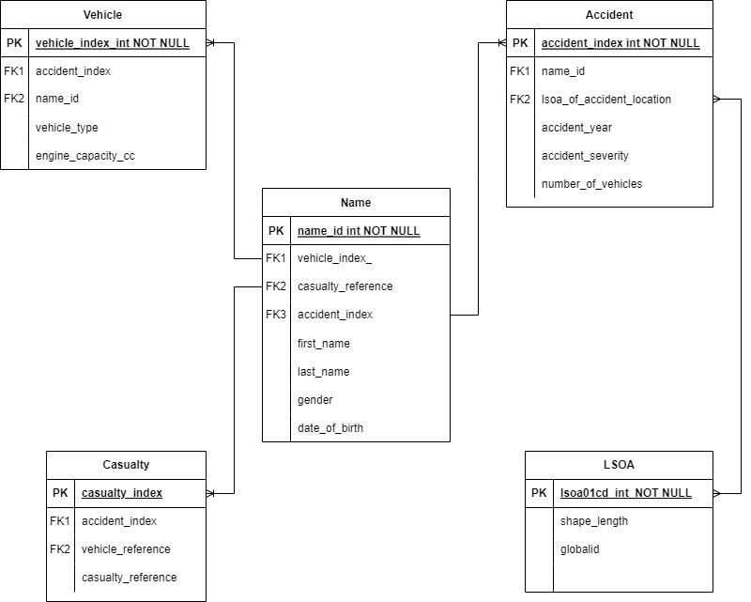
ER Diagram
Notes:
The provide diagram is designed on draw.io tool:
A new table has been added in the previous data that contains the name_id, first_name, last_name, gender of individual.
The name table can access the data from the other table for its reference.
Other tables show the minimal important data as per the given requirements only primary and foreign keys are included.
Detailed ER diagram:
Name Table:
name_id (Primary Key): Unique identifier for each individual's name.
accident_index (Foreign Key): Links to the accident_index in the Accident table to associate names with specific accidents.
vehicle_reference (Foreign Key): Links to the vehicle_reference in the Casualty table to associate names with specific vehicles involved in accidents.
casualty_reference (Foreign Key): Links to the casualty_reference in the Casualty table to associate names with specific casualties involved in accidents.
first_name: First name of the individual involved in the accident.
last_name: Last name of the individual involved in the accident.
Vehicle Table:
vehicle_index (Primary Key): Unique identifier for each vehicle involved in an accident.
accident_index (Foreign Key): Links to the accident_index in the Accident table to associate vehicles with specific accidents.
vehicle_type: Type of vehicle involved in the accident.
engine_capacity_cc: Engine capacity of the vehicle
Accident Table:
accident_index (Primary Key): Unique identifier for each accident.
accident_year: Year in which the accident occurred.
accident_severity: Severity of the accident (e.g., fatal, serious, slight).
number_of_vehicles: Number of vehicles involved in the accident.
lsoa_of_accident_location: Local Authority District code of the accident location (LSOA).
LSOA Table:
lsoa01cd (Primary Key): Unique identifier for each LSOA.
shape_length: Length of the shape representing the LSOA.
globalid: Global identifier for the LSOA.
Casualty Table:
casualty_index (Primary Key): Unique identifier for each casualty involved in an accident.
accident_index (Foreign Key): Links to the accident_index in the Accident table to associate casualties with specific accidents.
vehicle_reference (Foreign Key): Links to the vehicle_reference in the Vehicle table to associate casualties with specific vehicles involved in accidents.

Slide 9
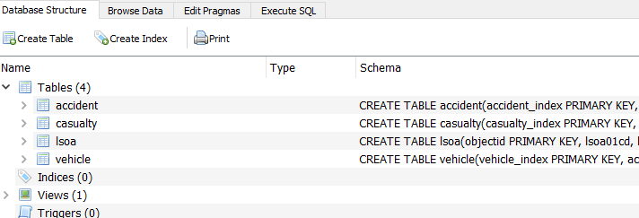
SQL Commands and Results
Database:

Slide 10
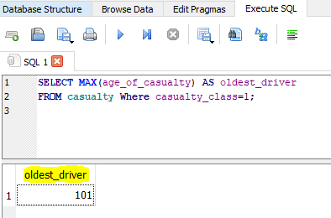
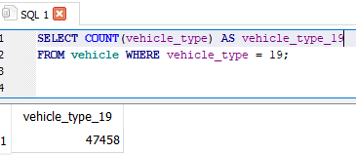
Continue..
1 age of oldest driver/rider:
SELECT MAX(age_of_casualty) AS oldest_driver
FROM casualty Where casualty_class=1;
2: total number of vehicle_type=19
SELECT COUNT(vehicle_type) AS vehicle_type_19
FROM vehicle WHERE vehicle_type = 19;

Slide 11
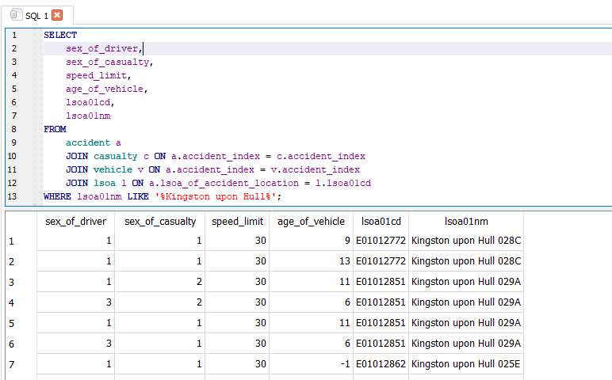
Continue..
SELECT
sex_of_driver,
sex_of_casualty,
speed_limit,
age_of_vehicle,
lsoa01cd,
lsoa01nm
FROM
accident a
JOIN casualty c ON a.accident_index = c.accident_index
JOIN vehicle v ON a.accident_index = v.accident_index
JOIN lsoa l ON a.lsoa_of_accident_location = l.lsoa01cd
WHERE lsoa01nm LIKE '%Kingston upon Hull%';

Slide 12


